Slide 1
5-dars(Model Building)
Davronbek Malikov

Slide 2

Bugun
Takrorlash
L1 va L2 Regularization
Lasso Regression
Lasso Regression: Amaliyot
Nimalar o’rgandik?
Imtixon

Slide 3
Takrorlash

Slide 4
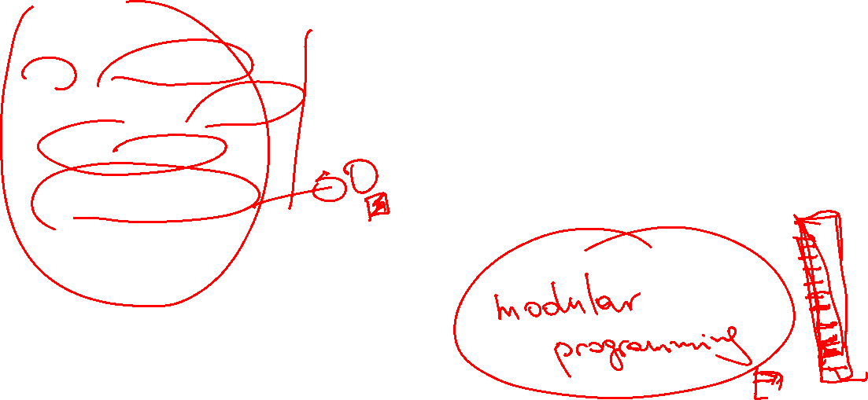
Takrorlash
Takrorlash
Os - kutubxonasi
Datasetlarni saqlash
Oraliq: Project
Ridge Regression
Vazifa

Slide 5

L1 va L2 Regularization

Slide 6
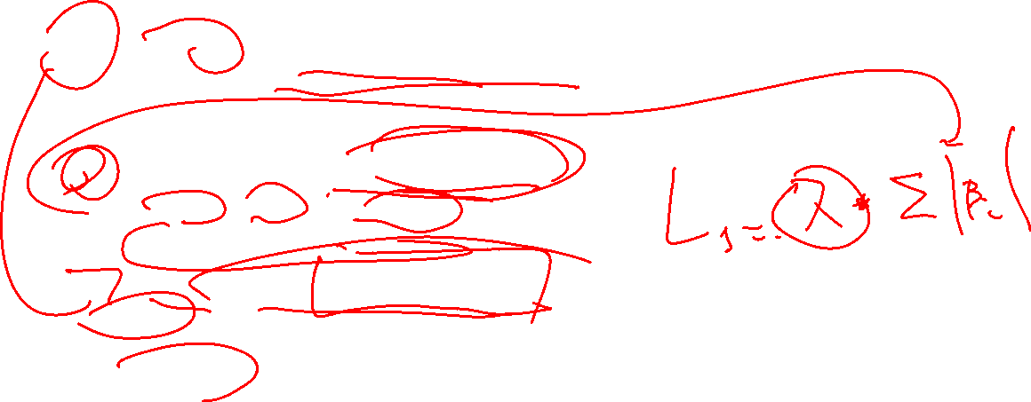
L1 va L2 Regularization
L1 Regularization(Lasso Regression)
Absolute value as a penalty
Muhim featurelar muhimligi
Bazi featurelarni tashlab yuboradi
Analogy:
Sumkamizda joy yoq shunda muhim bolmagan narsalar qoladi

Slide 7

L1 va L2 Regularization
L2 Regularization(Ridge Regression)
Squared value as a penalty
Bazi featurelarni tasirini kamaytiradi lekin tashab yubormaydi
Analogy:
Sumkamizda joy yoq lekin barcha narsalar muhim shunda compressor orqali ularni siqamiz va barchasini olib ketamiz(Mr Bean)

Slide 8
Lasso Regression

Slide 9

Lasso Regression
Linear Regression+ L1 Regularization
Uy prediction:
100 ta feature bor
Faqat 10 tasi muhim

Slide 10
Lasso Regression: Amaliyot

Slide 11
Lasso Regression: Amaliyot

Slide 12

Nimalar o’rgandik
ML
Python
Modular programming(basics)
Algorithms:
Lasso
Ridge
Kutubxonalar
Matplotlib
Seaborn
Plotlyexpress
Klib
Autoclean
Project 1
Built-in functions

Slide 13
Imtixon

Slide 14

Project
Tartibli
Natijalarni alohida papkada saqlang
Alohida projectlar uchun github profile oching
Qiziqarli idea
Talab qilinadigan qismlar:
Problem Statement
Feature va output xaqida malumot
Data preprocessing va datasetni saqlang
Data Analysis va report
Funksiya
Turli xil algorithmlar va ularni qiyoslang
Eng zor modelni tabulateda korsating va uni saqlang

Slide 15

Project
Topshiriladi va yuklanadi:
Data
Raw
Preprocessed
Data analysis
Model
Best model

